Slide 1
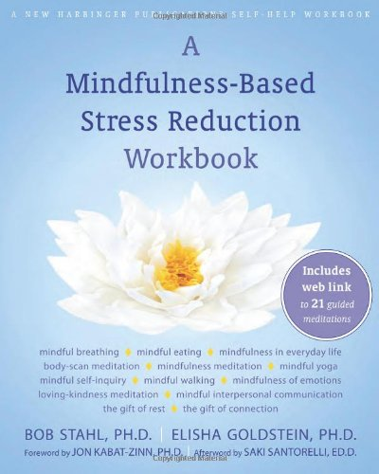
A Mindfulness-Based Stress Reduction Workbook A Program for Adolescents to Adults Goal: To look at how research and MBSR are effective for strengthening the immune system and increasing positive thoughts and emotions. MBSR teaches mindfulness practice and techniques for the alleviation of: Accumulated Daily Stress, Chronic Pain, Anxiety, High Blood Pressure, Depression, and many other conditions exacerbated by stress.

Slide 2
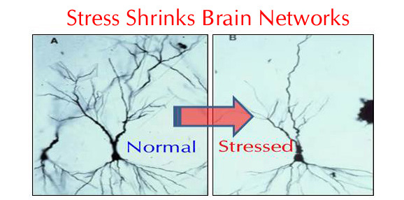
Why learn about Mindfulness Based Stress Reduction?
Our brains are overwhelmed by the stressful and accelerated pace of life and the assault of technology that has altered our lifestyles
We are susceptible to worry, panic, stress, sleeplessness, pain, self-judgement, and illness
stress and anxiety affect our lives, health, body and mind

Slide 5
History of Mindfulness-Based Stress Reduction
Mindfulness-based stress reduction (MBSR), is a clinically proven program developed in 1979 by Jon Kabat-Zinn a molecular biologist with a life long meditation practice, and Saki Santorelli, PH.D., at the University of Massachusetts Medical Center
MBSR is used to alleviate stress, anxiety, panic, depression, chronic pain, various medical conditions, and helping cancer patients
A Mindfulness Based Stress Reduction Workbook by Bob Stahl, PH.D. and Elisha Goldstein, PH.D., is an educational and experiential guide to the reduction of stress through mindfulness
The workbook teaches you that Mindfulness is to focus on the present moment and to permanently change the way you handle stress; through a mind-body connection
Mindfulness based therapies are used in over 250 hospitals around the world, including British Columbia Children’s Hospital

Slide 6
Stahl and Goldstein state they have created a ‘play book’ to weave mindfulness into your everyday life
The Mindfulness-Based Stress Reduction Workbook, teaches you to replace stress-promoting habits with new mindful ones
Develop life skills to help identify the causes of stress, and relieve the symptoms to live a healthier, happier life, and become more resilient
A guide to greater peace and healing in your life, emotions, hearing vs listening
Interpersonal Mindfulness skills, to cultivate a personal mindfulness practice for important relationships, work relationships, difficult people

Slide 7
Core Lessons in the MBSR Workbook
The program takes several weeks to complete the 10 chapters
What is Mindfulness?
Mindfulness and the Mind- Body Connection
How to Practice Mindfulness Meditation
How Mindfulness works with Stress Reduction
Mindfulness of the Body
Meditation for Anxiety and Stress
The Healthy Path of Mindful Eating, Exercise, Rest and Connection
Keeping up Your Practice once the lessons are completed

Slide 8
The Workbook in Action
Practice and time to understand the program are the basis for change, and creating the positive mind and body connection.
Journal, to enhance your practice
Mindful exploration, space to respond to questions about self reflection and support your practice
Just do it, suggestions on bringing mindfulness to daily activities, when you read it in the workbook you are invited to put down the book and ‘just do it!’ Experiencing being present in the moment
Formal Practice Log, briefly comment on what you experienced during practice
Aikido communication, art of peacemaking to break out of habitual reactions to stressful interaction
Deepening your practise, with breathing, yoga and mindfulness

Slide 9
CD to enhance Lessons and Daily Practice Guided Mindfulness Practices
Mindful eating – raisin
Mindful Check-In
Mindful Breathing (5&15 minutes)
Mindful Walking Meditation
Body Scan Meditation (15,30, & 45 minutes)
Sitting Meditation (15,30,& 45 minutes)
Mindful Yoga Introduction
Mindful Lying Yoga (15,30,& 45 minutes)
Meditation on Anxiety and Stress
Mindful Standing Yoga (15,30,& 45 minutes)
Loving -Kindness Meditation
8 and ½ hours of practice

Slide 10
Validity of the MBSR Workbook There has not been a study on the effects of the MBSR Workbook by Bob Stahl, PH.D. and Elisha Goldstein, PH.D. (2009). The authors validate the effectiveness of their Mindfulness-Based Stress Reduction workbook on more than thirty years of research in clinical and laboratory environments. Mindfulness has developed into a part of modern medicine and health care in various and continuously advancing ways (Krasner et al., 2009. Ludwig and Kabat-Zin 2008. Didonna 2008). The following two studies provide positive results to validate the MBSR workbook’s efficiency. A 2007 study by Baer, R., Carmody, J. on Relationships between mindfulness practice and levels of mindfulness, medical and psychological symptoms and well-being in a mindfulness-based stress reduction program indicated improvement in well-being of the participants. The research indicated that the practice of mindfulness meditation leads to increases in mindfulness, which in turn leads to a reduction of symptoms and improved well-being. Relationships were researched between home practice of mindfulness meditation exercises and levels of mindfulness, medical and psychological symptoms, perceived stress, and psychological well-being, with 174 adults in a clinical Mindfulness Based Stress Reduction (MBSR) program; an 8- session group program for individuals dealing with stress-related problems, illness, anxiety, and chronic pain. The adults recorded measures of mindfulness, perceived stress, symptoms, and wellbeing at pre- and post-MBSR, and tracked their home practice time. The results indicated increases in mindfulness and wellness, and decreases in stress and symptoms, from pre- to post-MBSR. Home practice of formal meditation exercises (body scan, yoga, sitting meditation) had a significant relation to the measure of improvement in most aspects of mindfulness, symptoms and well-being. Increases in mindfulness reflected in the relationships between formal mindfulness practice and increase in psychological functioning. A 2004 meta-analysis study on Mindfulness-based stress reduction and health benefits by Grossmana, et al., suggest that: MBSR is useful as an intervention for a varied range of chronic disorders and difficulties. The consistent and comparatively competent level of effect sizes across diverse types of samples indicates that mindfulness training may enhance basic features of coping with distress and disability in everyday life, and also under conditions of critical disorder or stress. .

Slide 11
MBSR Workbook Community
There is further opportunity to continue the practice once the lessons are completed to engage in the mindfulness based stress reduction practice
Online Support for MBSR Workbook
www.mbsrworkbook.com
A Facebook Community to discuss the MBSR Workbook. Engage with like-minded people to support the process of cultivating a mindfulness practice
Mindfulness Movie a documentary
by architect Paul Harrison, leaders in the field of mindfulness Rick Hanson, Dan Siegel, Mark Williams, Dan Millman, Kristin Neff, Jeffrey Schwartz, Jon Kabat -Zinn give important mindful insights
Stahl and Goldstein state that their MBSR Workbook is not a substitute for the MBSR program created by Kabat-Zinn and Santorelli, and list locations that offer the program in the Resource section of their book.

Slide 12
“Mindfulness is really a playful adventuring within life itself”
- Jon Kabat-Zinn

Slide 13
References and Resources:
Baer, R., Carmody, J. (2007). Relationships between mindfulness practice and levels of mindfulness, medical and psychological symptoms and well-being in a mindfulness-based stress reduction program. Journal of Behavioral Medicine, DOI 10.1007/s10865-007-9130-7
Grossmana, Niemannb, Schmidtc, and Walachc (2004). Mindfulness-based stress reduction and health benefits A Meta-analysis study. Journal of Psychosomatic Research 57, 35–43
Davidson, R. J., Kabat‐Zinn, J., Schumacher, J., Rosenkranz, M., Muller, D., Santorelli, Saki., Sheridan, J. F. (2003). Alterations in Brain and Immune Function. Produced by Mindfulness Meditation. Psychosomatic Medicine, 65, 564‐570.
Kabat-Zinn, J., Lipworth, L., & Burney, R. (1985). The clinical use of mindfulness meditation for the self-regulation of chronic pain. Journal of Behavioral Medicine, 8, 163–190.
Kabat-Zinn, J., Massion, A., Kristeller, J., Peterson, L., Fletcher, K.,Pbert, L., Linderking, W., & Santorelli, S. (1992). Effectiveness of a meditation-based stress reduction program in the treatment of anxiety disorders. American Journal of Psychiatry, 149, 936–943.
Roeser, R.W., Skinner, E., Beers, J., & Jennings, P.A. (2012). Mindfulness training and teachers’ professional development: An emerging area of research and practice. Child Development Perspectives, 6, 167-173.
Schonert‐Reichl, K. A., & Lawlor, M. S. (2010). The effects of a mindfulness‐based education program on pre‐ and early adolescents’ well‐being and social and emotional competence. Mindfulness, 1, 137–151.
Shapiroa,S., Bootzina, R., Figueredoa., A., Lopezb, A., Schwartza.,G. (2003) The efficacy of mindfulness-based stress reduction in the treatment of sleep disturbance in women with breast cancer An exploratory study. Journal of Psychosomatic Research 54, 85– 91.

